Slide 1
DML AND INDEXES
Lab # 8

Slide 2
DML ( DATA MANIPULATION LANGUAGE)
DML is short name of Data Manipulation Language which deals with data manipulation and includes most common SQL statements such SELECT, INSERT, UPDATE, DELETE, etc., and it is used to store, modify, retrieve, delete and update data in a database.
SELECT - retrieve data from a database
INSERT - insert data into a table
UPDATE - updates existing data within a table
DELETE - Delete all records from a database table

Slide 3
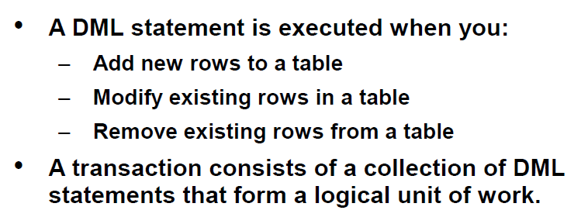
DML (Data Manipulation Language)

Slide 4
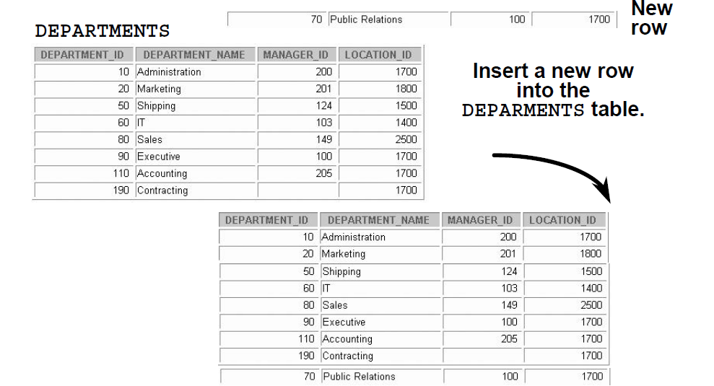
Adding a New Row to a Table

Slide 5
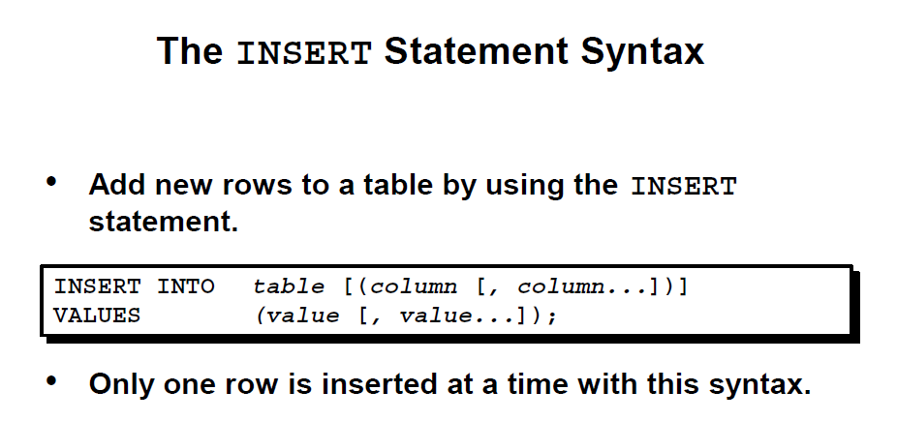
Insert Statement

Slide 6
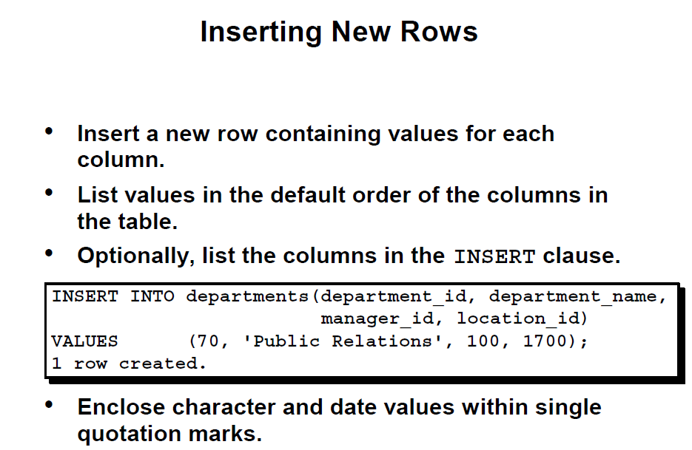
Inserting New Rows

Slide 7
Example
create table departments
(department_id int primary key,
department_name varchar (225),
manager_id int,
location_id int)
insert into departments(department_id,department_name,manager_id,location_id)
values (70, 'public relations',100,1700)
select * from departments

Slide 8
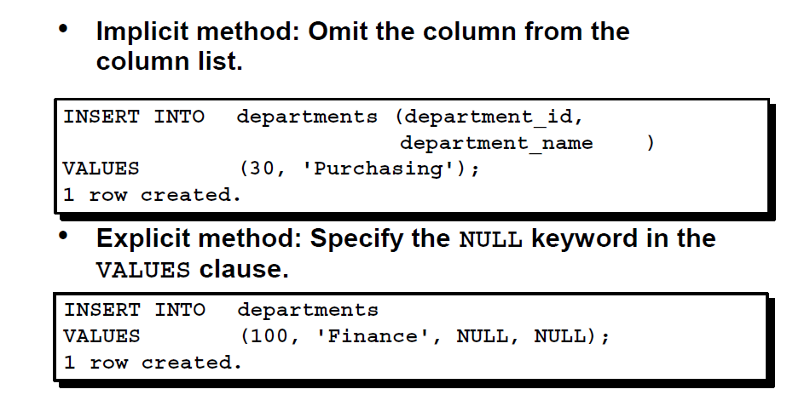
Inserting New Rows

Slide 9
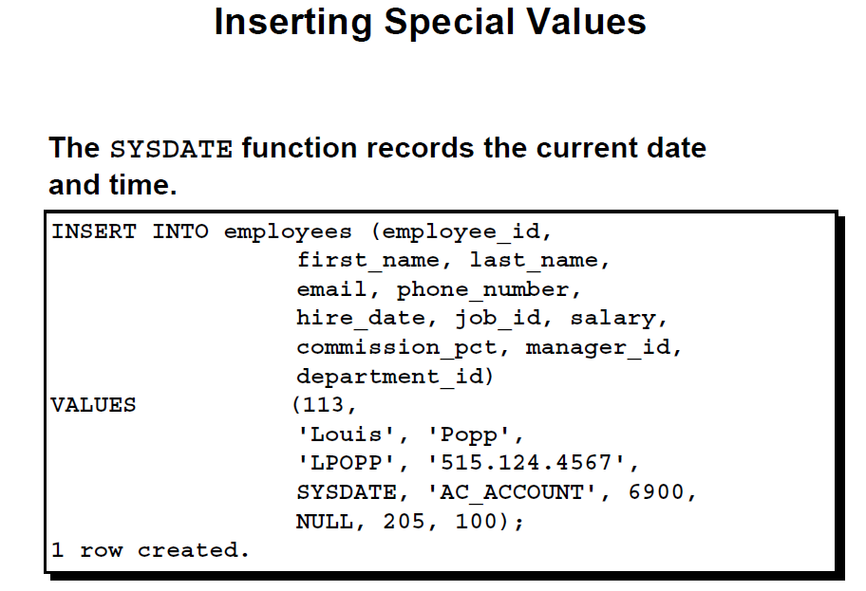
Inserting Special Values

Slide 10
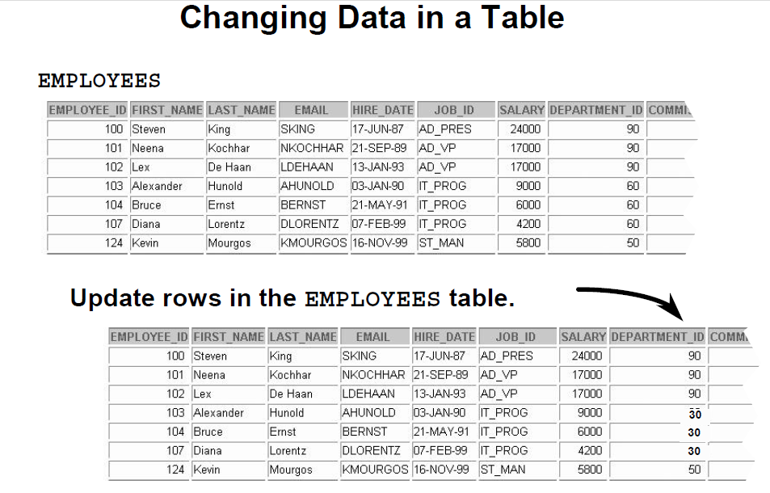
Changing Data in table

Slide 11
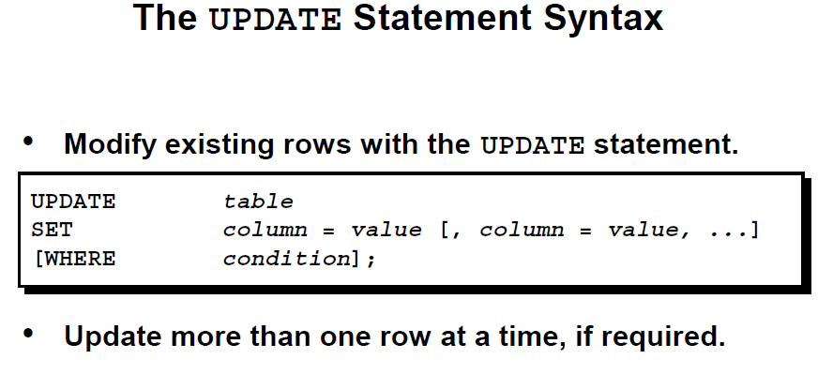
Update Statement

Slide 12
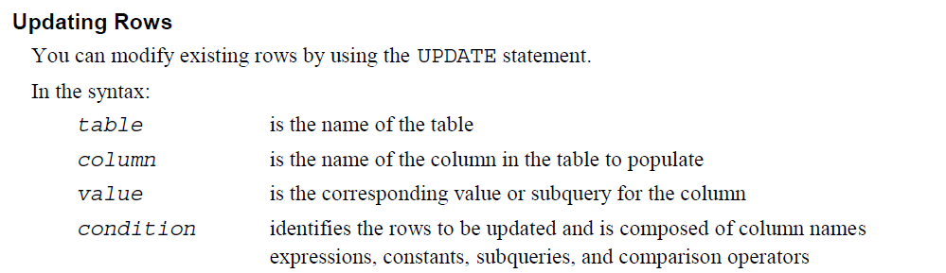
Update Statement

Slide 13
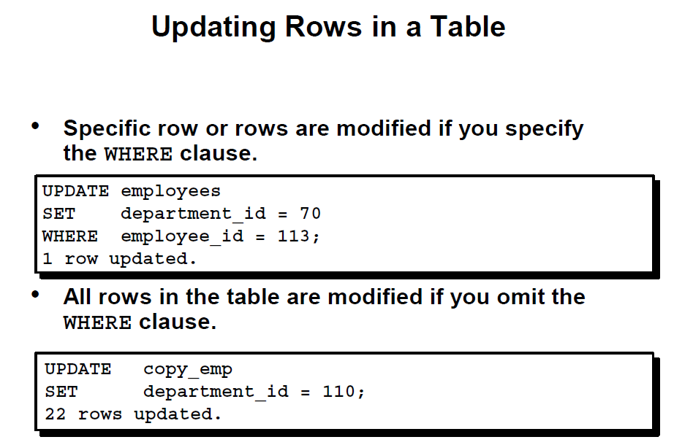
Update Statement

Slide 14
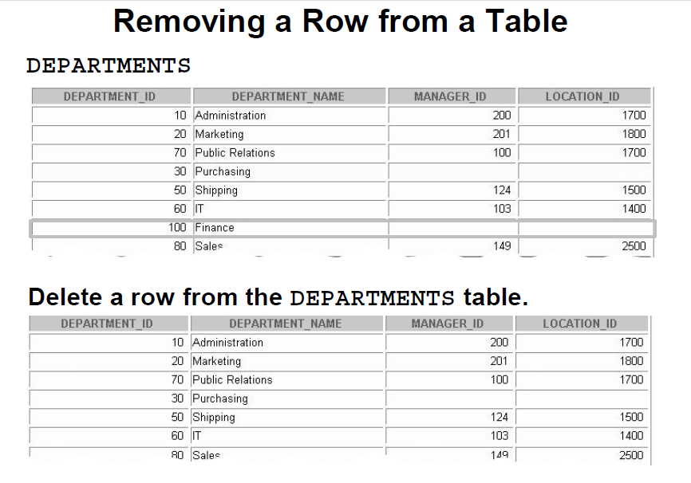
Removing a Row from the department Table

Slide 15
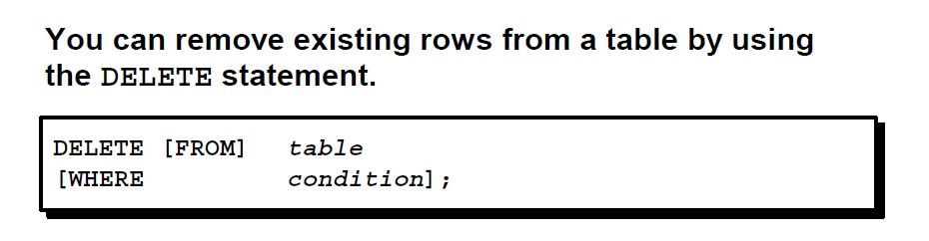
DELETE STATEMENT

Slide 16
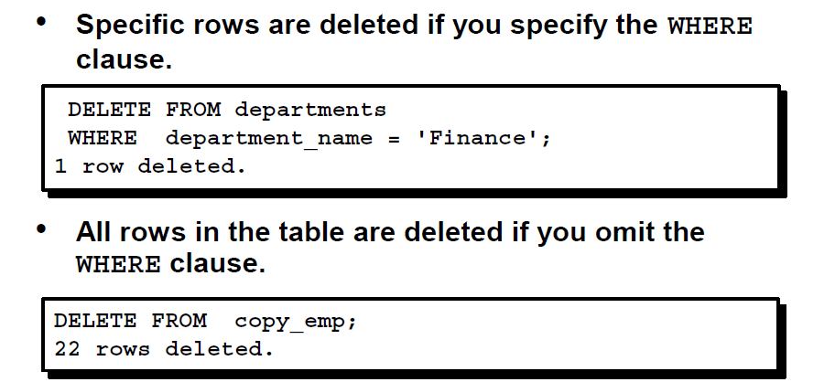
Deleting Row

Slide 17
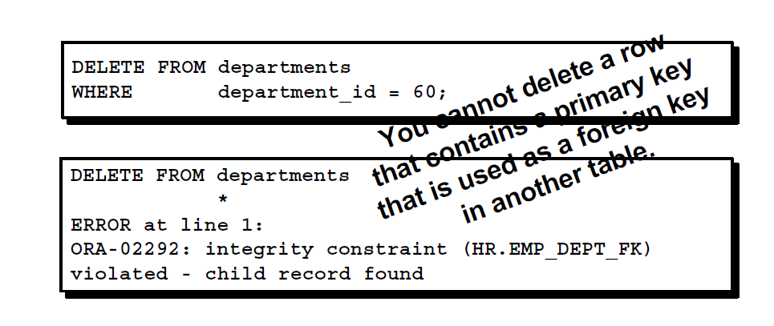
Deleting Rows Integrity Constraint Error

Slide 18
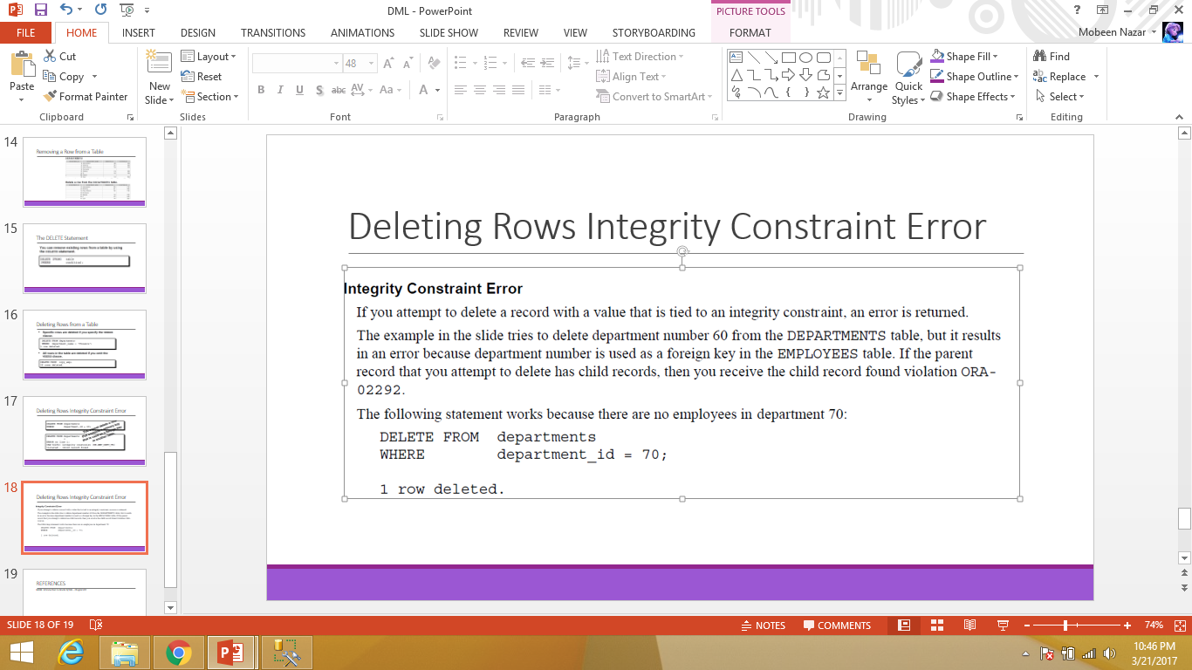
Deleting Record Integrity Constraint Error

Slide 19
INDEX
Indexes allow the database application to find data fast; without reading the whole table. They are similar to textbook indexes
An index can be created in a table to find data more quickly and efficiently
The users cannot see the indexes, they are just used to speed up searches/queries
If you create indexes, the database goes to that index first and then retrieves the corresponding table records directly.
Notes:
19

Slide 20
Index
Create Index:
Creates an index on a table. Duplicate values are allowed:
Syntax:
CREATE INDEX index_name ON table_name (column_name);

Slide 21
Types of Indexes
There are two types of Indexes in SQL Server:
Clustered Index
Non-Clustered Index

Slide 22
Clustered Index
A clustered index defines the order in which data is physically stored in a table.
Table data can be sorted in only way, therefore, there can be only one clustered index per table.
In SQL Server, the primary key constraint automatically creates a clustered index on that particular column.

Slide 23
Example
CREATE DATABASE schooldb
CREATE TABLE student
(
id INT PRIMARY KEY,
name VARCHAR(50) NOT NULL,
gender VARCHAR(50) NOT NULL,
DOB datetime NOT NULL,
total_score INT NOT NULL,
city VARCHAR(50) NOT NULL
)
Notice here in the “student” table we have set primary key constraint on the “id” column. This automatically creates a clustered index on the “id” column.
To see all the indexes on a particular table execute “sp_helpindex” stored procedure. This stored procedure accepts the name of the table as a parameter and retrieves all the indexes of the table.

Slide 24
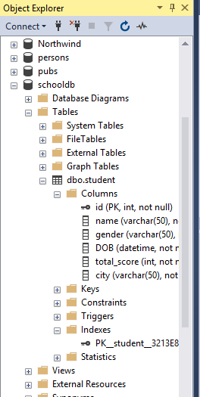
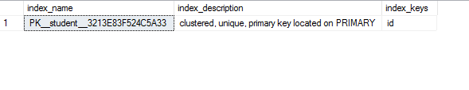
Example
USE schooldb
EXECUTE sp_helpindex student

Slide 25
Example
This clustered index stores the record in the student table in the ascending order of the “id”. Therefore, if the inserted record has the id of 5, the record will be inserted in the 5th row of the table instead of the first row. Similarly, if the fourth record has an id of 3, it will be inserted in the third row instead of the fourth row.
This is because the clustered index has to maintain the physical order of the stored records according to the indexed column

Slide 26
Example Clustered Index
USE schooldb
INSERT INTO student
VALUES
(6, 'Kate', 'Female', '03-JAN-1985', 500, 'Liverpool'),
(2, 'Jon', 'Male', '02-FEB-1974', 545, 'Manchester'),
(9, 'Wise', 'Male', '11-NOV-1987', 499, 'Manchester'),
(3, 'Sara', 'Female', '07-MAR-1988', 600, 'Leeds'),
(1, 'Jolly', 'Female', '12-JUN-1989', 500, 'London'),
(4, 'Laura', 'Female', '22-DEC-1981', 400, 'Liverpool'),
(7, 'Joseph', 'Male', '09-APR-1982', 643, 'London'),
(5, 'Alan', 'Male', '29-JUL-1993', 500, 'London'),
(8, 'Mice', 'Male', '16-AUG-1974', 543, 'Liverpool'),
(10, 'Elis', 'Female', '28-OCT-1990', 400, 'Leeds');
The above script inserts ten records in the student table. Notice here the records are inserted in random order of the values in the “id” column.
But because of the default clustered index on the id column, the records are physically stored in the ascending order of the values in the “id” column.
Execute the following SELECT statement to retrieve the records from the student table.
SELECT * FROM student

Slide 27
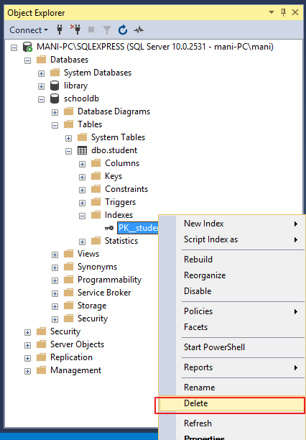
Custom Clustered Index
You can create your own custom index as well the default clustered index.
To create a new clustered index on a table you first have to delete the previous index.

Slide 28
Custom Clustered index Example
Now, to create a new clustered Index, execute the following script:
CREATE CLUSTERED INDEX IX_tblStudent_Gender_Score
ON student(gender ASC, total_score DESC)
The above script creates a clustered index named “IX_tblStudent_Gender_Score” on the student table. This index is created on the “gender” and “total_score” columns. An index that is created on more than one column is called “composite index”.
The above index first sorts all the records in the ascending order of the gender. If gender is same for two or more records, the records are sorted in the descending order of the values in their “total_score” column.

Slide 29
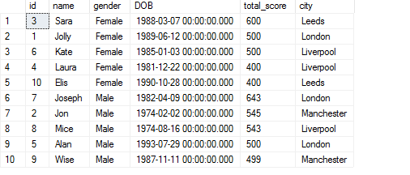
Example
Select * from student

Slide 30
Non Clustered Index
A non-clustered index doesn’t sort the physical data inside the table. In fact, a non-clustered index is stored at one place and table data is stored in another place.
This is similar to a textbook where the book content is located in one place and the index is located in another.
This allows for more than one non-clustered index per table.
It is important to mention here that inside the table the data will be sorted by a clustered index. However, inside the non-clustered index data is stored in the specified order.

Slide 31
Non Clustered Index
The index contains column values on which the index is created and the address of the record that the column value belongs to.
When a query is issued against a column on which the index is created, the database will first go to the index and look for the address of the corresponding row in the table. It will then go to that row address and fetch other column values.
It is due to this additional step that non-clustered indexes are slower than clustered indexes.

Slide 32
Example Non-Clustered Index
use schooldb
CREATE NONCLUSTERED INDEX IX_tblStudent_Name
ON student(name ASC)
The above script creates a non-clustered index on the “name” column of the student table. The index sorts by name in ascending order.
As we said earlier, the table data and index will be stored in different places. The table records will be sorted by a clustered index if there is one.
The index will be sorted according to its definition and will be stored separately from the table.

Slide 33
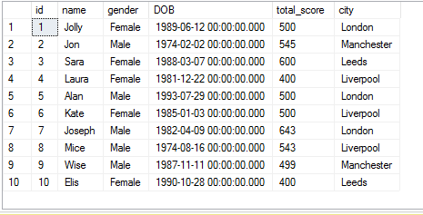
Example Clustered index
CREATE CLUSTERED INDEX IX_tblStudent_id
ON student(id ASC)

Slide 34
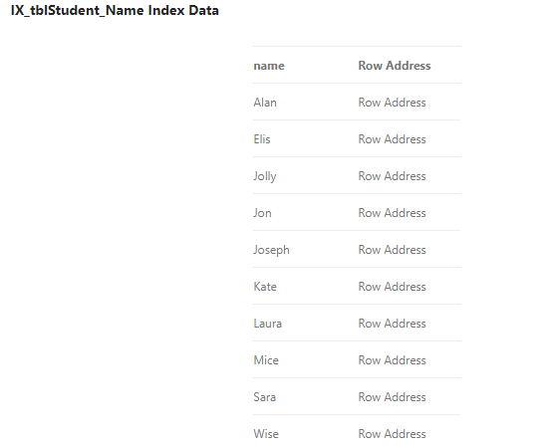
Non Clustererd Index
Notice, here in the index every row has a column that stores the address of the row to which the name belongs. So if a query is issued to retrieve the gender and DOB of the student named “Jon”, the database will first search the name “Jon” inside the index.
It will then read the row address of “Jon” and will go directly to that row in the “student” table to fetch gender and DOB of Jon.

Slide 35
Clustered vs Non Clustered
There can be only one clustered index per table. However, you can create multiple non-clustered indexes on a single table.
Clustered indexes only sort tables. Therefore, they do not consume extra storage. Non-clustered indexes are stored in a separate place from the actual table claiming more storage space.
Clustered indexes are faster than non-clustered indexes since they don’t involve any extra lookup step.

Slide 36
INDEX
CREATE UNIQUE INDEX Syntax
Creates a unique index on a table. Duplicate values are not allowed:
CREATE UNIQUE INDEX index_name ON table_name (column_name);
UNIQUE indicates that the combination of values in the indexed columns must be unique
Notes:
36

Slide 37
INDEX
Rename an Index
The syntax for renaming an index is:
ALTER INDEX index_name RENAME TO new_index_name;
Notes:
37

Slide 38
INDEX
Drop an Index
The syntax for dropping an index is:
DROP INDEX TableName.index_name;
Notes:
38

Slide 39
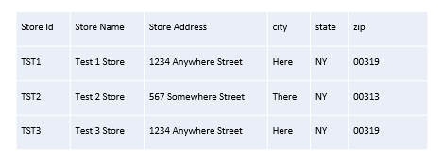
TASKS
1) Insert the following values to table Stores
Notes:
39

Slide 40
TASKS
Use Database Pubs for executing Queries from (Task 2-Task 6) below.
2) Add a new publisher whose name is Scotty and is in London UK.
3) Update address of “Eric the Read Books” to “700 Catamaugus Ave”.
4) Increment all discounts by 10%.
5) Delete employee whose id is “VPA30890F”.
6) Delete all Authors whose first name starts with M.
Notes:
40

Slide 41
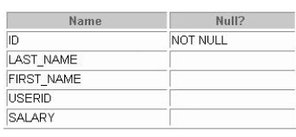
TASKS
7)Create table My_Employees with following Columns:
Notes:
41

Slide 42
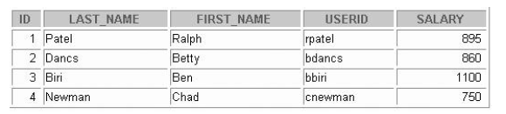
TASKS
8) Insert these 5 records in above mentioned table My_Employees.
Notes:
42

Slide 43
TASKS
Use table My_Employees to solve the queries (9-12) mentioned below:
9) Concatenate ID, first two letters of the FIRST_NAME and first seven characters of the LAST_NAME to produce the USERID in employee table
10) Change the LAST_NAME of employee 3 to ALPHA
11) Change the salary to 1000 for all employees with a SALARY less than 900.
12) Delete Betty Dancs from the My_Employees Table.
Indexes
13)Create a unique index on the order table using EmployeeID (Use Northwind)
14)Create a non-clustered index on the OrderDate column of the Orders table (Use Northwind)
15)Delete the index you created in Task # 14 (Use Northwind) .
16)Create a clustered index on the region table using regionid (Use Northwind)
Notes:
43

